Slide 1
CSE 4109: Artificial Intelligence Natural Language Processing (NLP)
M.M.A. Hashem, PhD
Professor,
Dept of Computer Science and Engineering
KUET, Khulna 9203

Slide 2
References
The essence of Artificial Intelligence
By A. Cawsey
Prentice Hall Europe 1998
Artificial Intelligence: Theory and Practice
By T. Dean, J. Allen, and Y. Aloimonos.
The Benjamin/Cummings Publishing Company, 1995
Artificial Intelligence
By P. Winston
Addison Wesley, 1992
Artificial Intelligence: A Modern Approach
By Russell and Norvig
Prentice Hall, 2003
Recent Deep Learning + NLP developments, circa 2010-2020

Slide 3
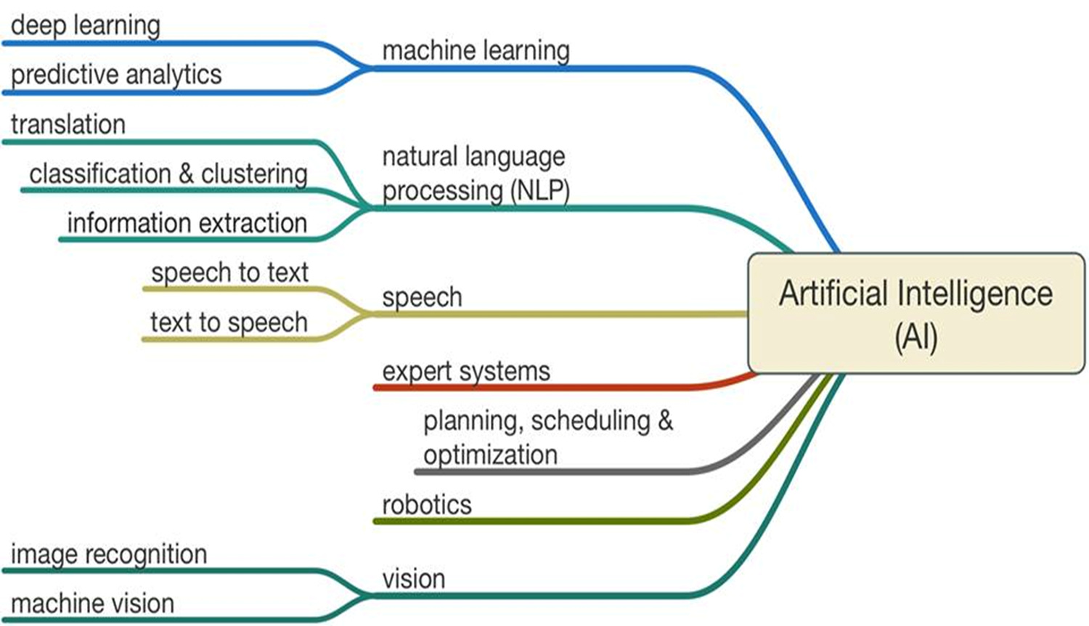
Artificial Intelligence Demystified

Slide 4
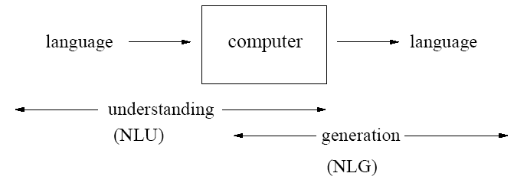
What is NLP?
Natural Language Processing (NLP) is a field in Artificial Intelligence (AI) devoted to creating computer Systems that use natural language as input and/or output.

Slide 5
Why NLP
To interact with computing devices using human (natural) languages. For example,
Building intelligent robots (AI).
Enabling voice-controlled operation.
To access (large amount of) information and knowledge stored in the form of human languages quickly.

Slide 6
Communication Typical communication episode S (speaker) wants to convey P (proposition) to H (hearer) using W (words in a formal or natural language)
1. Speaker
Intention: S wants H to believe P
Generation: S chooses words W
Synthesis: S utters words W
2. Hearer
Perception: H perceives words W” (ideally W” = W)
Analysis: H infers possible meanings P1,P2,…,Pn for W”
Disambiguation: H infers that S intended to convey Pi (ideally Pi=P)
Incorporation: H decides to believe or disbelieve Pi

Slide 7
Natural Language Processing (NLP)
Natural Language Understanding
Taking some spoken/typed sentence and working out what it means
Natural Language Generation
Taking some formal representation of what you want to say and working out a way to express it in a natural (human) language (e.g., English)

Slide 8
Applications of Nat. Lang. Processing
Machine Translation
Database Access
Information Retrieval
Selecting from a set of documents the ones that are relevant to a query
Text Categorization
Sorting text into fixed topic categories
Extracting data from text
Converting unstructured text into structured data
Spoken language control systems
Spelling and grammar checkers

Slide 9
Natural language understanding
Raw speech signal
Speech recognition
Sequence of words spoken
Syntactic analysis using knowledge of the grammar
Structure of the sentence
Semantic analysis using info. about meaning of words
Partial representation of meaning of sentence
Pragmatic analysis using info. about context
Final representation of meaning of sentence

Slide 10
Natural Language Understanding
Input/Output data Processing stage Other data used
Frequency spectrogram freq. of diff.
speech recognition sounds
Word sequence grammar of
“He loves Mary” syntactic analysis language
Sentence structure meanings of
semantic analysis words
He loves Mary
Partial Meaning context of
∃x loves(x,Mary) pragmatics utterance
Sentence meaning
loves(John,Mary)

Slide 11

Speech Recognition (1 of 3)
Input Analog Signal Freq. spectrogram
(microphone records voice) (e.g., Fourier transform)
Hz
time

Slide 12
Speech Recognition (2 of 3)
Frequency spectrogram
Basic sounds in the signal (40-50 phonemes) (e.g., “a” in “cat”)
Template matching against a database of phonemes
Using dynamic time warping (speech speed)
Constructing words from phonemes (e.g., “th”+”i”+”ng”=thing)
Unreliable/probabilistic phonemes (e.g., “th” 50%, “f” 30%, …)
Non-unique pronunciations (e.g., tomato),
statistics of transitions phonemes/words (hidden Markov models)
Words

Slide 13
Speech Recognition - Complications
No simple mapping between sounds and words
Variance in pronunciation due to gender, dialect, …
Restriction to handle just one speaker
Same sound corresponding to diff. words
e.g., bear, bare
Finding gaps between words
“how to recognize speech”
“how to wreck a nice beach”
Noise

Slide 14
Syntactic Analysis
Rules of syntax (grammar) specify the possible organization of words in sentences and allows us to determine sentence’s structure(s)
“John saw Mary with a telescope”
John saw (Mary with a telescope)
John (saw Mary with a telescope)
Parsing: given a sentence and a grammar
Checks that the sentence is correct according with the grammar and if so returns a parse tree representing the structure of the sentence

Slide 15
Syntactic Analysis - Grammar
sentence -> noun_phrase, verb_phrase
noun_phrase -> proper_noun
noun_phrase -> determiner, noun
verb_phrase -> verb, noun_phrase
proper_noun -> [mary]
noun -> [apple]
verb -> [ate]
determiner -> [the]

Slide 16
Syntactic Analysis - Parsing
sentence
noun_phrase verb_phrase
proper_noun verb noun_phrase
determiner noun
“Mary” “ate” “the” “apple”

Slide 17
Syntactic Analysis – Complications (1)
Number (singular vs. plural) and gender
sentence-> noun_phrase(n),verb_phrase(n)
proper_noun(s) -> [mary]
noun(p) -> [apples]
Adjective
noun_phrase-> determiner,adjectives,noun
adjectives-> adjective, adjectives
adjective->[ferocious]
Adverbs, …

Slide 18
Syntactic Analysis – Complications (2)
Handling ambiguity
Syntactic ambiguity: “fruit flies like a banana”
Having to parse syntactically incorrect sentences

Slide 19
Semantic Analysis
Generates (partial) meaning/representation of the sentence from its syntactic structure(s)
Compositional semantics: meaning of the sentence from the meaning of its parts:
Sentence: A tall man likes Mary
Representation: ∃x man(x) & tall(x) & likes(x,Mary)
Grammar + Semantics
Sentence (Smeaning)-> noun_phrase(NPmeaning),verb_phrase(VPmeaning), combine(NPmeaning,VPmeaning,Smeaning)

Slide 20
Semantic Analysis – Complications
Handling ambiguity
Semantic ambiguity: “I saw the Prudential building flying into Boston”

Slide 21
Pragmatics
Uses context of utterance
Where, by who, to whom, why, when it was said
Intentions: inform, request, promise, criticize, …
Handling Pronouns
“Mary eats apples. She likes them.”
She=“Mary”, them=“apples”.
Handling ambiguity
Pragmatic ambiguity: “you’re late”: What’s the speaker’s intention: informing or criticizing?

Slide 22
Natural Language Generation
Talking back! ☺
What to say or text planning
flight(AA,london,boston,$560,2pm),
flight(BA,london,boston,$640,10am),
How to say it
“There are two flights from London to Boston. The first one is with American Airlines, leaves at 2 pm, and costs $560 …”
Speech synthesis
Simple: Human recordings of basic templates
More complex: string together phonemes in phonetic spelling of each word
Difficult due to stress, intonation, timing, liaisons between words

Slide 23
New advancements in NLP
Tremendous advances in the 2010’s have yielded synergistic connections between machine learning and NLP
Work in Deep Learning in recent years has revolutionized NLP both in terms of:
Natural language understanding
Natural language generation
Emergence of highly accomplished NLP academic prototypes & commercial products

